Slide 1
CHAPTER 3 Evaluating a Company’s External Environment

Slide 2
LEARNING OBJECTIVES
THIS CHAPTER WILL HELP YOU UNDERSTAND:
How to recognize the factors in a company’s broad macro-environment that may have strategic significance
How to use analytic tools to diagnose the competitive conditions in a company’s industry
How to map the market positions of key groups of industry rivals
How to use multiple frameworks to determine whether an industry’s outlook presents a company with sufficiently attractive opportunities for growth and profitability

Slide 3
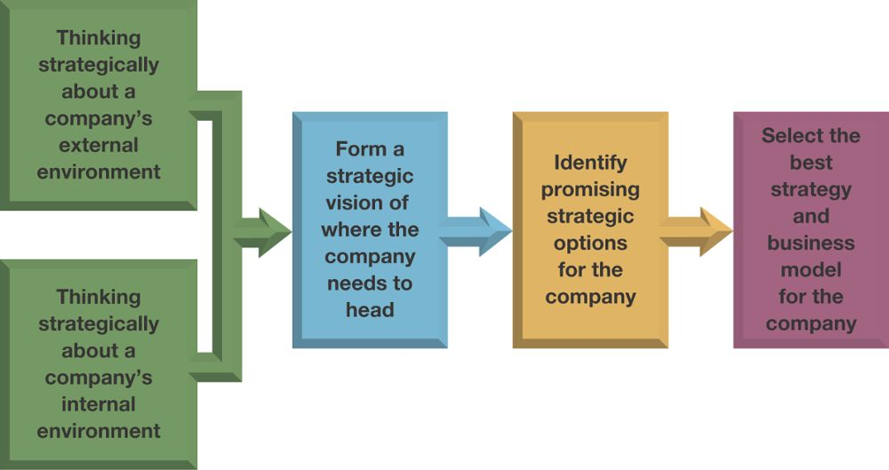
FIGURE 3.1 From Thinking Strategically about the Company’s Situation to Choosing a Strategy
Chapter 3
Chapter 4
Jump to Appendix 1 long image description

Slide 4
CORE CONCEPT (1 of 7)
The macro-environment encompasses the broad environmental context in which a company’s industry is situated that includes strategically relevant components over which the firm has no direct control.

Slide 5
CORE CONCEPT (2 of 7)
PESTEL analysis focuses on the six principal components of strategic significance in the macro-environment.
Political
Economic
Social
Technological
Environmental
Legal

Slide 6
THE STRATEGICALLY RELEVANT FACTORS IN THE COMPANY'S MACRO-ENVIRONMENT
PESTEL Analysis
Focuses on principal components of strategic significance in the macro-environment
Political factors
Economic conditions (local to worldwide)
Sociocultural forces
Technological factors
Environmental factors (the natural environment)
Legal and regulatory conditions

Slide 7
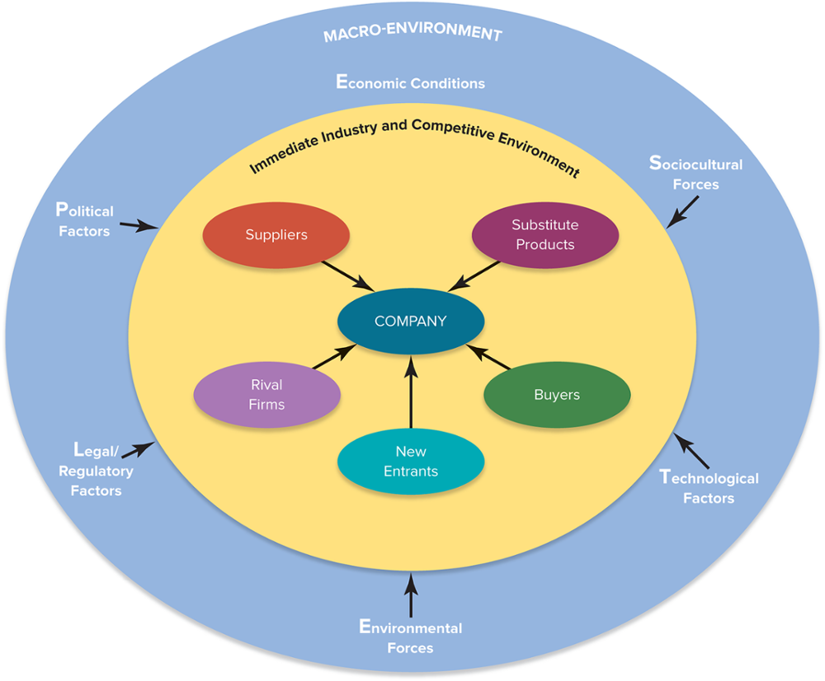
FIGURE 3.2 The Components of a Company’s Macro-Environment
Jump to Appendix 2 long image description

Slide 8
ASSESSING A COMPANY’S INDUSTRY AND COMPETITIVE ENVIRONMENT
How strong are the industry’s competitive forces?
What are the driving forces in the industry, and what impact will they have on competitive intensity and industry profitability?
What market positions do industry rivals occupy—who is strongly positioned and who is not?
What strategic moves are rivals likely to make next?
What are the industry’s key success factors?
Is the industry outlook conducive to good profitability?

Slide 9
THE FIVE FORCES FRAMEWORK
The five competitive forces
Competition from rival sellers
Competition from potential new entrants
Competition from producers of substitute products
Supplier bargaining power
Customer bargaining power

Slide 10
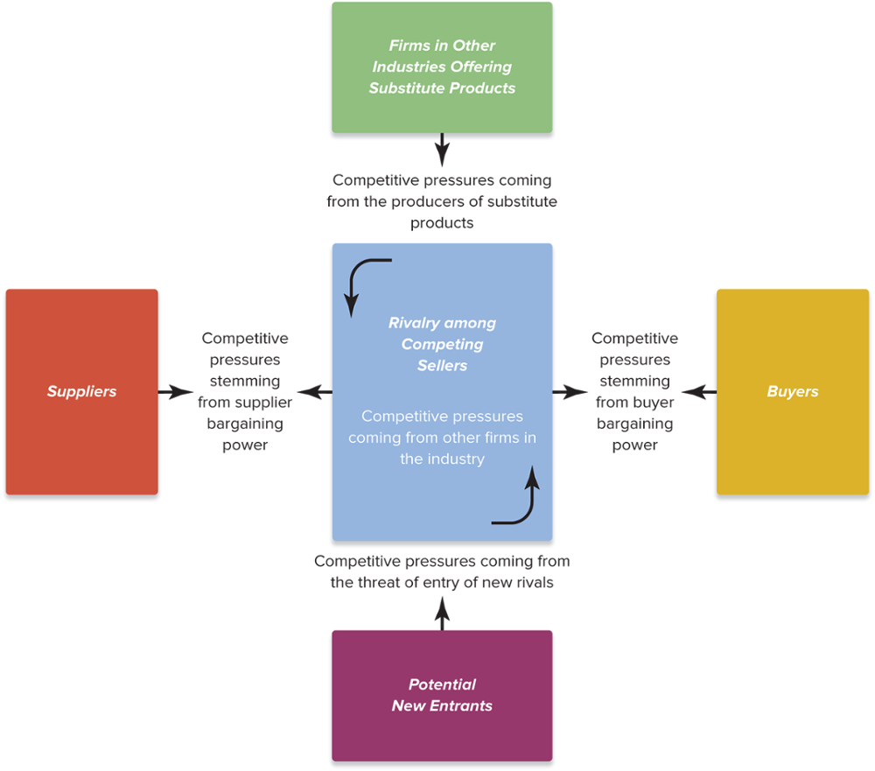
FIGURE 3.3 The Five-Forces Model of Competition: A Key Analytical Tool
Jump to Appendix 3 long image description

Slide 11
USING THE FIVE-FORCES MODEL OF COMPETITION
Step 1
For each of the five forces, identify the different parties involved, along with the specific factors that bring about competitive pressures.
Step 2
Evaluate how strong the pressures stemming from each of the five forces are (strong, moderate, or weak).
Step 3
Determine whether the five forces, overall, are supportive of high industry profitability.
Jump to Appendix 4 long image description

Slide 12
COMPETITIVE PRESSURES THAT INCREASE RIVALRY AMONG COMPETING SELLERS
Buyer demand is growing slowly or declining.
It is becoming less costly for buyers to switch brands.
Industry products are becoming less differentiated.
There is unused production capacity, or products have high fixed costs or high storage costs.
The number of competitors is increasing or they are becoming more equal in size and competitive strength.
The diversity of competitors is increasing.
High exit barriers keep firms from exiting the industry.

Slide 13
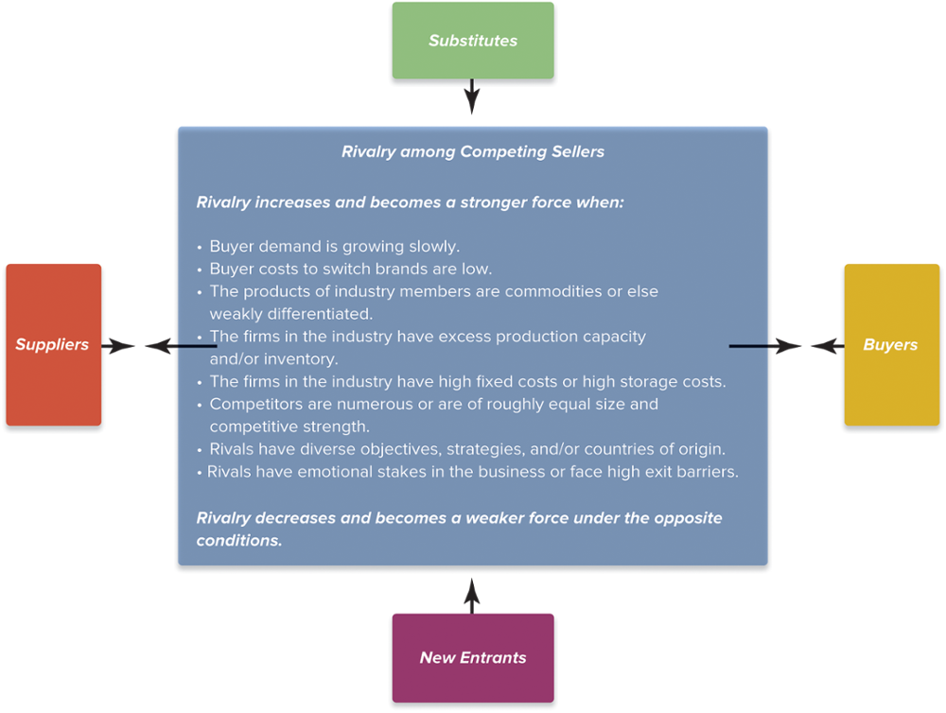
FIGURE 3.4 Factors Affecting the Strength of Rivalry
Jump to Appendix 5 long image description

Slide 14
COMPETITIVE PRESSURES ASSOCIATED WITH THE THREAT OF NEW ENTRANTS
Entry threat considerations
Expected defensive reactions of incumbent firms
Strength of barriers to entry
Attractiveness of a particular market’s growth in demand and profit potential
Capabilities and resources of potential entrants
Entry of existing competitors into market segments in which they have no current presence

Slide 15
MARKET ENTRY BARRIERS FACING NEW ENTRANTS
Incumbent cost advantages related to learning and experience, proprietary patents and technology, favorable locations, and lower fixed costs
Strong brand preferences and customer loyalty
Strong “network effects” in customer demand
High capital requirements
Building a network of distributors or dealers and securing adequate space on retailers’ shelves
Restrictive regulatory and trade policies

Slide 16
STRATEGIC MANAGEMENT PRINCIPLE (1 of 8)
Whether an industry’s entry barriers ought to be considered high or low depends on the resources and capabilities possessed by the pool of potential entrants.
High entry barriers and weak entry threats today do not always translate into high entry barriers and weak entry threats tomorrow.

Slide 17
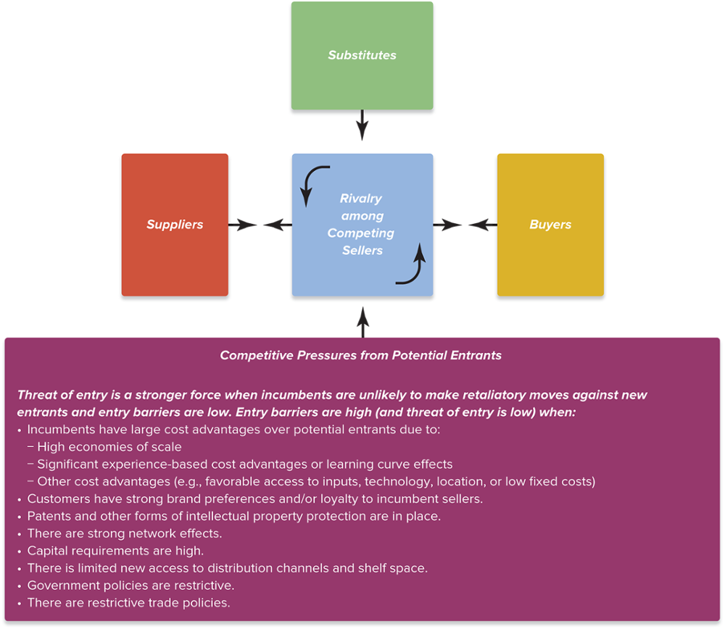
FIGURE 3.5 Factors Affecting the Threat of Entry
Jump to Appendix 6 long image description

Slide 18
COMPETITIVE PRESSURES FROM THE SELLERS OF SUBSTITUTE PRODUCTS
Substitute products considerations
Readily available and attractively priced?
Comparable or better in terms of quality, performance, and other relevant attributes?
Offer lower switching costs to buyers?
Indicators of substitutes’ competitive strength
Increasing rate of growth in sales of substitutes
Substitute producers adding new output capacity
Increasing profitability of substitute producers

Slide 19
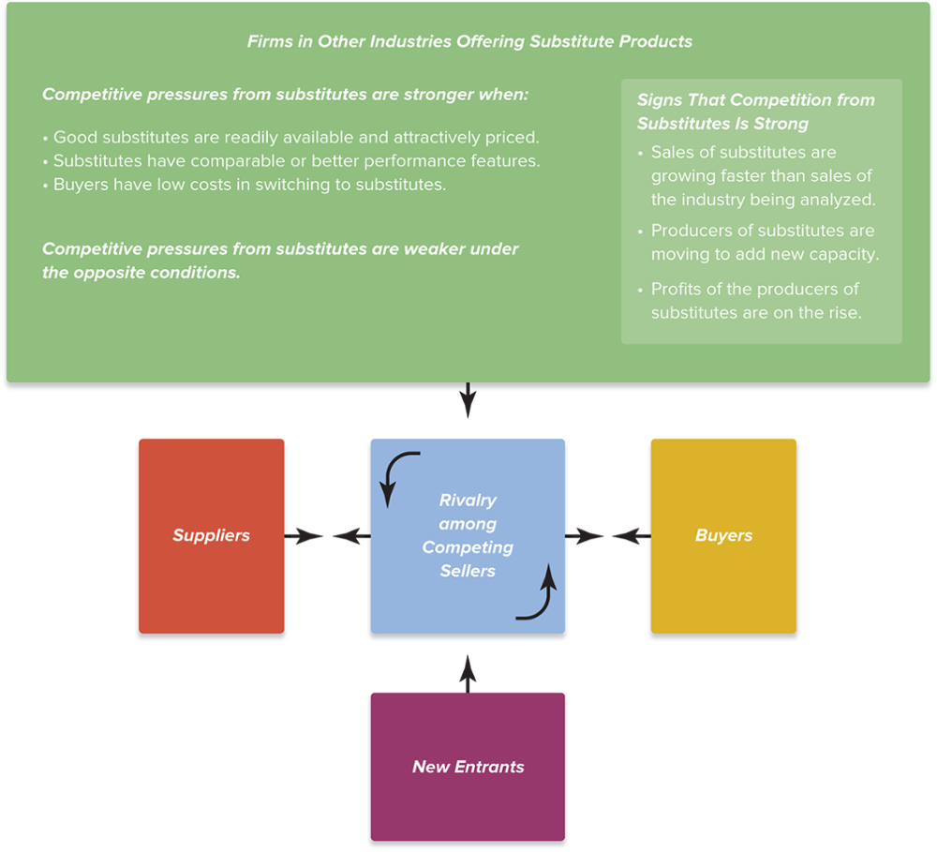
FIGURE 3.6 Factors Affecting Competition from Substitute Products
Jump to Appendix 7 long image description

Slide 20
COMPETITIVE PRESSURES STEMMING FROM SUPPLIER BARGAINING POWER
Supplier bargaining power depends on:
Strength of demand for and availability of suppliers’ products
Whether suppliers provide a differentiated input that enhances the performance of the industry’s product
Industry members’ costs for switching among suppliers
Size and number of suppliers relative to industry members
Possibility of backward integration into suppliers’ industry
Fraction of the cost of the supplier’s product relative to the total cost of the industry’s product
Availability of good substitutes for suppliers’ products
Whether industry members are major customers of suppliers

Slide 21
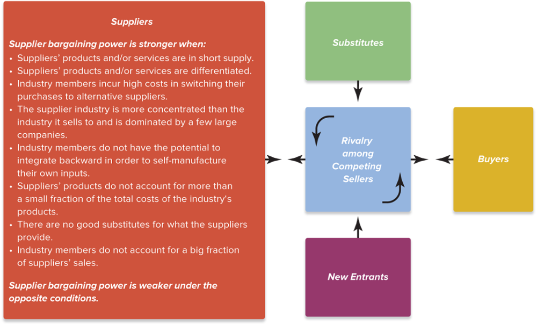
FIGURE 3.7 Factors Affecting the Bargaining Power of Suppliers
Jump to Appendix 8 long image description

Slide 22
COMPETITIVE PRESSURES STEMMING FROM BUYER BARGAINING POWER AND PRICE SENSITIVITY
Buyer bargaining power considerations
Strength of buyers’ demand for sellers’ products
Degree to which industry goods are differentiated
Buyers’ costs for switching to competing sellers or substitutes
Number and size of buyers relative to number of sellers
Threat of buyers’ integration into sellers’ industry
Buyers’ knowledge of products, costs and pricing
Buyers’ discretion in delaying purchases
Buyers’ price sensitivity due to low profits, size of purchase, and consequences of purchase

Slide 23
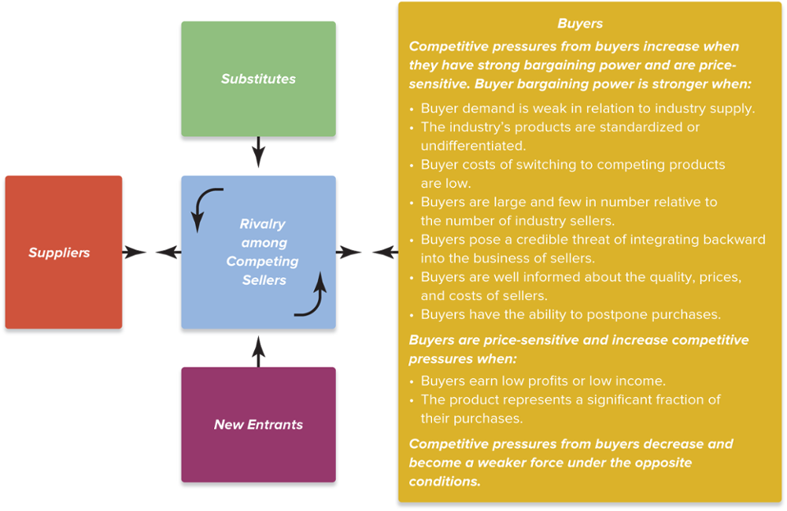
FIGURE 3.8 Factors Affecting the Bargaining Power of Buyers
Jump to Appendix 9 long image description

Slide 24
IS THE COLLECTIVE STRENGTH OF THE FIVE COMPETITIVE FORCES CONDUCIVE TO GOOD PROFITABILITY?
Is the state of competition in the industry stronger than normal?
Can industry firms expect to earn decent profits given prevailing competitive forces?
Are some of the competitive forces sufficiently powerful to undermine industry profitability?
Even one powerful force may be enough to make the industry unattractive in terms of its profit potential

Slide 25
CORE CONCEPT (3 of 7)
The strongest of the five forces determines the extent of the downward pressure on an industry’s profitability.
Having more than one strong force means that an industry has multiple competitive challenges with which to cope.

Slide 26
MATCHING COMPANY STRATEGY TO COMPETITIVE CONDITIONS
Effectively matching a firm’s business strategy to prevailing competitive conditions has two aspects
Pursuing avenues that shield the firm from as many competitive pressures as possible
Initiating actions calculated to shift competitive forces in the firm’s favor by altering underlying factors driving the five forces

Slide 27
STRATEGIC MANAGEMENT PRINCIPLE (2 of 8)
A company’s strategy is increasingly effective the more it provides some insulation from competitive pressures, shifts the competitive battle in the company’s favor, and positions firms to take advantage of attractive growth opportunities.

Slide 28
COMPLEMENTORS AND THE VALUE NET
How the value net differs from the five forces
Focuses on the interactions of industry participants with a particular (focal) company
Defines the category of competitors to include the focal firm’s direct competitors, industry rivals, the sellers of substitute products, and potential entrants
Introduces a new category of industry participant—complementors—producers of products that enhance the value of the focal firm’s products when they are used together

Slide 29
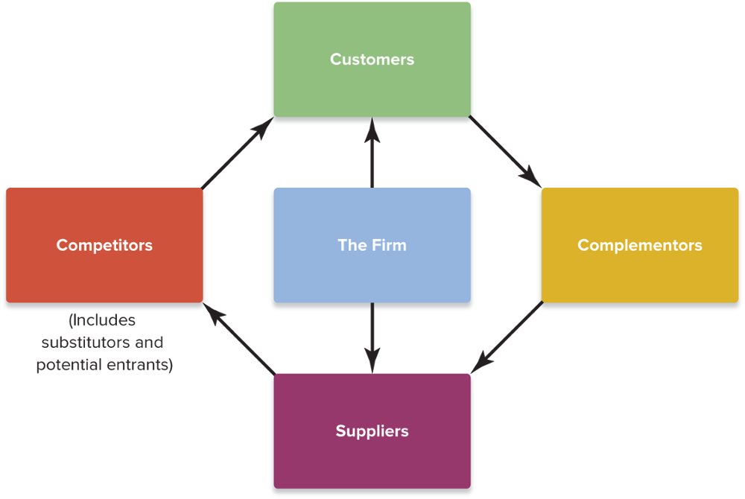
FIGURE 3.9 The Value Net
Jump to Appendix 10 long image description

Slide 30
CORE CONCEPT (4 of 7)
Complementors are the producers of complementary products, which are products that enhance the value of the focal firm’s products when they are used together.

Slide 31
INDUSTRY DYNAMICS AND THE FORCES DRIVING CHANGE
Driving forces analysis has three steps
Identifying what the driving forces are
Assessing whether the drivers of change are, on the whole, acting to make the industry more or less attractive
Determining what strategy changes are needed to prepare for the impact of the driving forces

Slide 32
CORE CONCEPT (5 of 7)
Driving forces are the major underlying causes of change in industry and competitive conditions.

Slide 33
THE MOST COMMON DRIVERS OF INDUSTRY CHANGE
Changes in the long-term industry growth rate
Increasing globalization
Emerging new Internet capabilities and applications
Shifts in buyer demographics
Technological change and manufacturing process innovation
Product and marketing innovation
Entry or exit of major firms
Diffusion of technical know-how across companies and countries
Changes in cost and efficiency
Reductions in uncertainty and business risk
Regulatory influences and government policy changes
Changing societal concerns, attitudes, and lifestyles

Slide 34
STRATEGIC MANAGEMENT PRINCIPLE (3 of 8)
The most important part of driving forces analysis is to determine whether the collective impact of the driving forces will increase or decrease market demand, make competition more or less intense, and lead to higher or lower industry profitability.

Slide 35
ASSESSING THE IMPACT OF THE FACTORS DRIVING INDUSTRY CHANGE
Are the driving forces, on balance, acting to cause demand for the industry’s product to increase or decrease?
Is the collective impact of the driving forces making competition more or less intense?
Will the combined impacts of the driving forces lead to higher or lower industry profitability?

Slide 36
STRATEGIC MANAGEMENT PRINCIPLE (4 of 8)
The real payoff of driving-forces analysis is to help managers understand what strategy changes are needed to prepare for the impacts of the driving forces.

Slide 37
ADJUSTING STRATEGY TO PREPARE FOR THE IMPACTS OF DRIVING FORCES
What strategy adjustments will be needed to deal with the impacts of the driving forces?
What adjustments must be made immediately?
What actions currently being taken should be halted or abandoned?
What can we do now to prepare for adjustments we anticipate making in the future?

Slide 38
STRATEGIC GROUP ANALYSIS
Strategic group
Consists of those industry members with similar competitive approaches and positions in the market
Having comparable product-line breadth
Emphasizing the same distribution channels
Depending on identical technological approaches
Offering the same product attributes to buyers
Offering similar services and technical assistance

Slide 39
CORE CONCEPT (6 of 7)
A strategic group is a cluster of industry rivals that have similar competitive approaches and market positions.
Strategic group mapping is a technique for displaying the different market or competitive positions that rival firms occupy in the industry.

Slide 40
USING STRATEGIC GROUP MAPS TO ASSESS THE MARKET POSITIONS OF KEY COMPETITORS
Constructing a strategic group map
Identify the competitive characteristics that delineate strategic approaches used in the industry.
Plot the firms on a two-variable map using pairs of competitive characteristics.
Assign firms occupying about the same map location to the same strategic group.
Draw circles around each strategic group, making the circles proportional to the size of the group’s share of total industry sales revenues.

Slide 41
TYPICAL VARIABLES USED IN CREATING GROUP MAPS
Price and quality range (high, medium, low)
Geographic coverage (local, regional, national, global)
Product-line breadth (wide, narrow)
Degree of service offered (no frills, limited, full)
Distribution channels (retail, wholesale, Internet, multiple)
Degree of vertical integration (none, partial, full)
Degree of diversification into other industries (none, some, considerable)

Slide 42
GUIDELINES FOR CREATING GROUP MAPS
Variables selected as map axes should not be highly correlated.
Variables should reflect important (sizable) differences among rival approaches.
Variables may be quantitative, continuous, discrete, or defined in terms of distinct classes and combinations.
Drawing group circles proportional to the combined sales of firms in each group will reflect the relative sizes of each strategic group.
Drawing maps using different pairs of variables will show the different competitive positioning relationships present in the industry’s structure.

Slide 43
STRATEGIC MANAGEMENT PRINCIPLE (5 of 8)
Strategic group maps reveal which firms are close competitors and which are distant competitors.

Slide 44
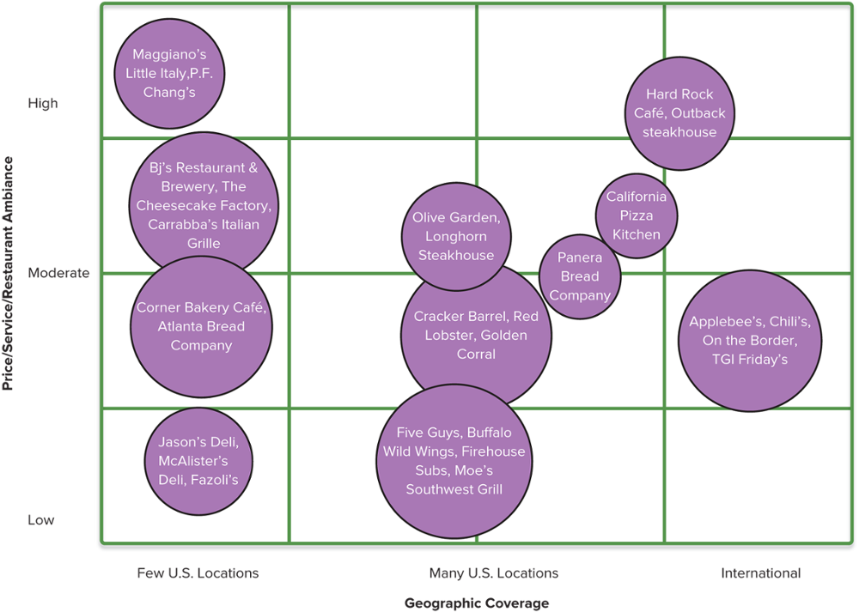
Illustration Capsule 3.1 Comparative Market Positions of Selected Firms in the Casual Dining Industry: A Strategic Group Map Example
Footnote: Circles are drawn roughly proportional to the sizes of the chains, based on revenues.
Jump to Appendix 11 long image description

Slide 45
Examining the Comparative Market Positions of Strategic Groups in the Casual Dining Industry
Which strategic group is located in the least favorable market position? Which group is in the most favorable position?
Which strategic group is likely to experience increased intragroup competition?
Which groups are most threatened by the likely strategic moves of members of nearby strategic groups?

Slide 46
STRATEGIC MANAGEMENT PRINCIPLE (6 of 8)
Some strategic groups are more favorably positioned than others because they confront weaker competitive forces or because they are more favorably impacted by industry driving forces.

Slide 47
THE VALUE OF STRATEGIC GROUP MAPS
Maps are useful in identifying which industry members are close rivals and which are distant rivals.
Not all map positions are equally attractive
Prevailing competitive pressures from the industry’s five forces may cause the profit potential of different strategic groups to vary.
Industry driving forces may favor some strategic groups and hurt others.

Slide 48
COMPETITOR ANALYSIS
Competitive intelligence
Information about rivals that is useful in anticipating their next strategic moves
Signals of the likelihood of strategic moves
Rivals under pressure to improve financial performance
Rivals seeking to increase market standing
Public statements of rivals’ intentions
Profiles developed by competitive intelligence units

Slide 49
STRATEGIC MANAGEMENT PRINCIPLE (7 or 8)
Studying competitors’ past behavior and preferences provides a valuable assist in anticipating what moves rivals are likely to make next and outmaneuvering them in the marketplace.

Slide 50
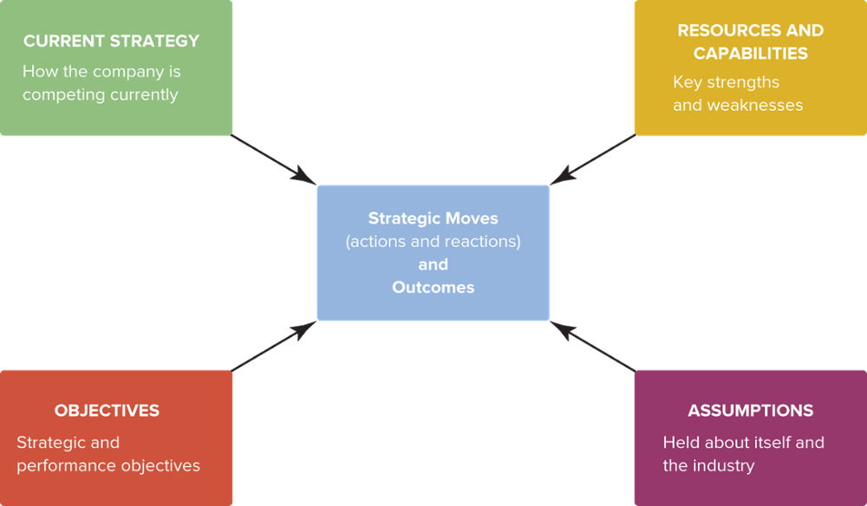
FIGURE 3.10 A Framework for Competitor Analysis
Jump to Appendix 12 long image description

Slide 51
A FRAMEWORK FOR COMPETITOR ANALYSIS
Indicators of a rival firm’s likely strategic moves and countermoves
The rival firm’s current strategy
The rival firm’s objectives
The rival firm’s capabilities
The rival firm’s assumptions about itself and its industry

Slide 52
USEFUL QUESTIONS TO HELP PREDICT THE LIKELY ACTIONS OF IMPORTANT RIVALS
Which competitors’ strategies are achieving good results?
Which competitors are losing in the marketplace or badly need to increase unit sales and market share?
Which rivals are likely make major moves to enter new geographic markets or to increase sales and market share in a particular geographic region?
Which rivals can expand product offerings to enter new product segments where they do not have a presence?
Which rivals can be acquired? Which rivals are financially able and looking to make an acquisition?

Slide 53
CREATING A STRATEGIC PROFILE OF A RIVAL COMPETITOR FIRM (1 of 2)
Current strategy
How is the competitor positioned in the market?
What is the basis for its competitive advantage?
What kinds of investments is it making (as an indicator of its expected growth trajectory)?
Objectives
What are its financial performance objectives?
What are its strategic objectives?
How well is it performing in meeting its objectives?
Is it under pressure to improve its performance?

Slide 54
CREATING A STRATEGIC PROFILE OF A RIVAL COMPETITOR FIRM (2 of 2)
Resources and capabilities
What is the competitor’s current set of resources and capabilities?
What weaknesses does it have?
Which capabilities is it making efforts to obtain?
Assumptions
What do the competitor’s top managers believe about their strategic situation?
How will their beliefs affect the competitor’s behavior in the market?

Slide 55
KEY SUCCESS FACTORS
Key success factors (KSFs)
Are the strategy elements, product and service attributes, operational approaches, resources, and competitive capabilities that are necessary for competitive success by any and all firms in an industry.
These vary from industry to industry, and over time within the same industry, and in importance as drivers of change and competitive conditions change.

Slide 56
CORE CONCEPT (7 of 7)
Key success factors are the strategy elements, product and service attributes, operational approaches, resources, and competitive capabilities that are essential to surviving and thriving in the industry.

Slide 57
IDENTIFICATION OF KEY SUCCESS FACTORS
On what basis do buyers of the industry’s product choose between the competing brands of sellers? What product attributes and service characteristics are crucial to competitive success?
Given the nature of competitive rivalry prevailing in the marketplace, what resources and competitive capabilities must a firm have to be competitively successful?
What shortcomings are almost certain to put a firm at a significant competitive disadvantage?

Slide 58
THE INDUSTRY OUTLOOK FOR PROFITABILITY
An industry environment is fundamentally attractive if it presents a company with good opportunity for above-average profitability.
An industry environment is fundamentally unattractive if a firm’s profit prospects in the industry are unappealingly low.

Slide 59
FACTORS TO CONSIDER IN ASSESSING INDUSTRY ATTRACTIVENESS
How the firm is impacted by the state of the macro-environment
Whether strong competitive forces are squeezing industry profitability to subpar levels
Whether the presence of complementors and the possibility of cooperative actions improve the company’s prospects
Whether industry profitability will be favorably or unfavorably affected by the prevailing driving forces
Whether the firm occupies a stronger market position than rivals
Whether this is likely to change in the course of competitive interactions
How well the firm’s strategy delivers on industry key success factors

Slide 60
STRATEGIC MANAGEMENT PRINCIPLE (8 of 8)
The degree to which an industry is attractive or unattractive is not the same for all industry participants and all potential entrants.

Slide 61
INDUSTRY ATTRACTIVENESS IS NOT THE SAME FOR ALL PARTICIPANTS
Industry outsiders may conclude that they have the resources to easily hurdle the barriers to entering an attractive industry while other outsiders may find the same industry unattractive because they do not want to challenge market leaders and have better opportunities elsewhere.
A particular industry’s attractiveness depends in large part on whether a company has the resources and capabilities to be competitively successful and profitable in that environment.

Slide 62
WHAT SHOULD A CURRENT COMPETITOR DECIDE ABOUT ITS INDUSTRY?
When a competitor decides an industry is attractive, it should invest aggressively to capture the opportunities it sees and to improve its long-term competitive position in the business.
When a strong competitor concludes its industry is relatively unattractive and lacking in opportunity, it may elect to protect its present position, investing cautiously if at all and looking for opportunities in other industries.
A competitively weak company in an unattractive industry may see its best option as finding a buyer, perhaps a rival, to acquire its business.

Slide 63
Appendix 1 Figure 3.1 From Thinking Strategically about the Company’s Situation to Choosing a Strategy
Thinking strategically about a company's external (Chapter 3) and internal (Chapter 4) environments helps to:
Form a strategic vision of where the company needs to head.
Identify promising strategic options for the company, then.
Select the best strategy and business model for the company.
Return to slide

Slide 64
Appendix 2 Figure 3.2 The Components of a Company’s Macro-Environment
A company's macroenvironment includes the economic conditions, sociocultural forces, environmental forces, legal and regulatory forces, and political forces.
The immediate industry and competitive environment includes the company, suppliers, substitute products, buyers, new entrants, and rival firms.
Return to slide

Slide 65
Appendix 3 Figure 3.3 The Five-Forces Model of Competition: A Key Analytical Tool
Rivalry among competing sellers is at the center of the graphic. Text reads, “Competitive pressures come from other firms in the industry” Surrounding this are four other types of forces and their competitive pressures:
Firms in other industries offering substitute products. Competitive pressures coming from the producers of substitute products.
Buyers. Competitive pressures stemming from buyer bargaining power.
Potential new entrants. Competitive pressures coming from the threat of entry of new rivals.
Suppliers. Competitive pressures stemming from supplier bargaining power.
All four forces have arrows pointing toward the center’s rivalry among competing sellers. In turn, rivalry among competing sellers has two arrows pointing outward, one toward buyers, and one toward suppliers.
Return to slide

Slide 66
Appendix 4 Using the Five=Forces Model of Competition
Step 1: For each of the five forces, identify the different parties involved, along with the specific factors that bring about competitive pressures.
Step 2: Evaluate how strong the pressures stemming from each of the five forces are (strong, moderate, or weak).
Step 3: Determine whether the five forces, overall, are supportive of high industry profitability.
Return to slide

Slide 67
Appendix 5 Figure 3.4 Factors Affecting the Strength of Rivalry
The five-forces model of competition is displayed, showing the relations of the substitute products, new entrants, suppliers, and buyers. Within the central box, rivalry among competing sellers, is text which reads: Rivalry increases and becomes a stronger force when:
Buyer demand is growing slowly
Buyer costs to switch brands are low
The products of industry members are commodities or else weakly differentiated
The firms in the industry have excess production capacity or inventory
The firms in the industry have high fixed costs or high storage costs
Competitors are numerous or are of roughly equal size and competitive strength
Rivals have diverse objectives, strategies, or countries of origin
Rivals have emotional stakes in the business or face high exit barriers
Rivalry decreases and becomes a weaker force under the opposite conditions.
Return to slide

Slide 68
Appendix 6 Figure 3.5 Factors Affecting the Threat of Entry
The five-forces model of competition is displayed. Within the box, competitive pressures from potential entrants, is text which reads: threat of entry is a stronger force when incumbents are unlikely to make retaliatory moves against new entrants and entry barriers are low. Entry barriers are high (and threat of entry is low) when:
Incumbents have large cost advantages over potential entrants due to high economies of scale; significant experience-based cost advantages or learning curve effects; and other cost advantages (e.g., favorable access to inputs, technology, location, or low fixed costs)
Customers have strong brand preferences and/or loyalty to incumbent sellers.
Patents and other forms of intellectual property protection are in place.
There are strong network effects.
Capital requirements are high.
There is limited new access to distribution channels and shelf space.
Government policies are restrictive.
There are restrictive trade policies.
Return to slide

Slide 69
Appendix 7 Figure 3.6 Factors Affecting Competition from Substitute Products
The five-forces model of competition is displayed. Within the box, “Firms in other industries offering substitute products”, is text which reads:
Competitive pressures from substitutes are stronger when:
Good substitutes are readily available and attractively priced.
Substitutes have comparable or better performance features.
Buyers have low costs in switching to substitutes.
Competitive pressures from substitutes are weaker under the opposite conditions.
A box also lists signs that competition from substitutes is strong:
Sales of substitutes are growing faster than sales of the industry being analyzed.
Producers of substitutes are moving to add new capacity.
Profits of the producers of substitutes are on the rise.
Return to slide

Slide 70
Appendix 8 Figure 3.7 Factors Affecting the Bargaining Power of Suppliers
The five-forces model of competition is displayed. Within the box titled Suppliers is text which reads:
Supplier bargaining power is stronger when:
Suppliers’ products and or services are in short supply
Suppliers’ products and or services are differentiated
Industry members incur high costs in switching their purchases to alternative suppliers
The supplier industry is more concentrated than the industry it sells to and is dominated by a few large companies
Industry members do not have the potential to integrate backward in order to self-manufacture their own inputs
Suppliers’ products do not account for more than a small fraction of the total costs of the industry’s products
There are no good substitutes for what the suppliers provide
Industry members do not account for a big fraction of suppliers’ sales.
Supplier bargaining power is weaker under the opposite conditions.
Return to slide

Slide 71
Appendix 9 Figure 3.8 Factors Affecting the Bargaining Power of Buyers
The five-forces model of competition is displayed. Within the box, “Buyers,” is text which reads:
Competitive pressures from buyers increase when they have strong bargaining power and are price-sensitive. Buyer bargaining power is stronger when:
Buyer demand is weak in relation to industry supply.
The industry’s products are standardized or undifferentiated.
Buyer costs of switching to competing products are low.
Buyers are large and few in number relative to the number of industry sellers.
Buyers pose a credible threat of integrating backward into the business of sellers.
Buyers are well informed about the quality, prices, and costs of sellers.
Buyers have the ability to postpone purchases.
Buyers are price-sensitive and increase competitive pressures when:
Buyers earn low profits or low income.
The product represents a significant fraction of their purchases.
Competitive pressures from buyers decrease and become a weaker force under the opposite conditions.
Return to slide

Slide 72
Appendix 10 Figure 3.9 The Value Net
The value net shows the firm in the center, surrounded by customers, complementors, suppliers, and competitors (which includes substitutors and potential entrants).
Return to slide

Slide 73
Appendix 11 Illustration Capsule 3.1 Comparative Market Positions of Selected Firms in the Casual Dining Industry: A Strategic Group Map Example
A four-by-four grid is displayed. The vertical axis, labeled “Price/Service/ Restaurant ambiance,” is labeled “Low” at its base and “High” at its top. The horizontal axis, “Geographic Coverage,” is labeled “Few U.S. Locations” at left, “Many U.S. Locations” at the axis midpoint and “International” at right.
Circles labeled with the names of casual dining firms are placed throughout the grid. One strategic group with members of varying levels of Price/Service/Ambiance is clustered at the left of Geographic Coverage. A second strategic group is generally located at the midpoint of Geographic Coverage with no firm in the group reaching the upper area of the Price/Service/ambiance scale. A third group is distributed between the midpoint and upper end of the Geographic Coverage scale with the majority of its members at and above the midpoint of the Price/Service/Ambiance scale.
The sizes of the labeled circles are roughly proportional to the sizes of the rival chains based on revenues. The proportional sizes of firms within all groups (based on revenues) varies from large to small.
Return to slide

Slide 74
Appendix 12 Figure 3.10 A Framework for Competitor Analysis
Five boxes are shown. Four boxes have arrows pointing to a central box. The central box is labeled “Strategic moves (actions and reactions) and outcomes.” The surrounding four boxes are labeled as follows:
Resources and capabilities: Key strengths and weaknesses
Assumptions: Held about itself and the industry
Objectives: Strategic and performance objectives
Current strategy: How the company is competing currently.
Return to slide

